Slide 1
Problem statement :
Write a program to convert a number between 1 and 100000 into its English word format.

Slide 2
Input:
An integer n representing the number to be converted, where 1 <= n <= 100000.
Output:
A string representing the English word format of the input number.

Slide 3
Examples:
Input: 123
Output: one hundred twenty three
Input: 10001
Output: ten thousand one
Input: -100 (Optional)
Output: negative one hundred (one hundred) - enough
Constraints:
The program must handle numbers up to 100000.
The program should be written in Java / C / C++.

Slide 4
Approaching the problem :
Case 1 :
input : 0
output : zero
Case 2 : (number names)
input : 1 to 19
output : one to nineteen

Slide 5
Approaching the problem :
Case 3 : (optional)
input : -6
output : negative six
Case 4 : (tens name)
input : 20, 30, 40, 50, ... 90
output : twenty, thirty, forty, fifty, ... ninety

Slide 6
Approaching the problem :
Case 5 : (special names)
input : 100, 1000, 100000
output : hundred, thousand, lakh
Case 6 :
input : 7464
output : seven thousand four hundred sixty four

Slide 7
Approaching the problem :
Case 5 :
input : 178
output : one hundred seventy eight
Case 6 :
input : 9999
output : nine thousand nine hundred ninety nine

Slide 8
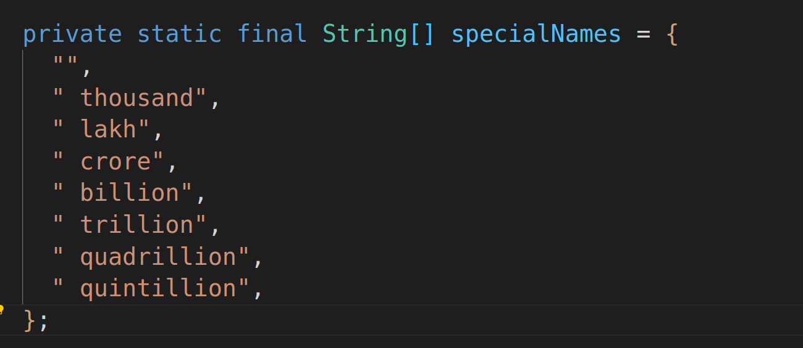

Slide 9
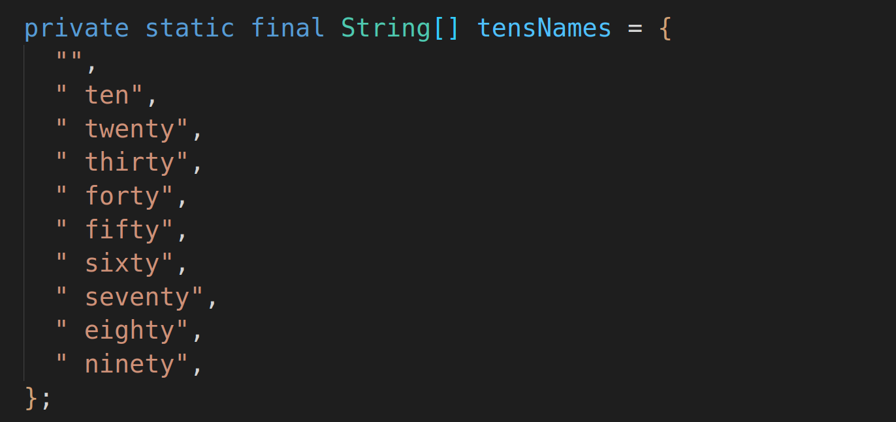

Slide 11
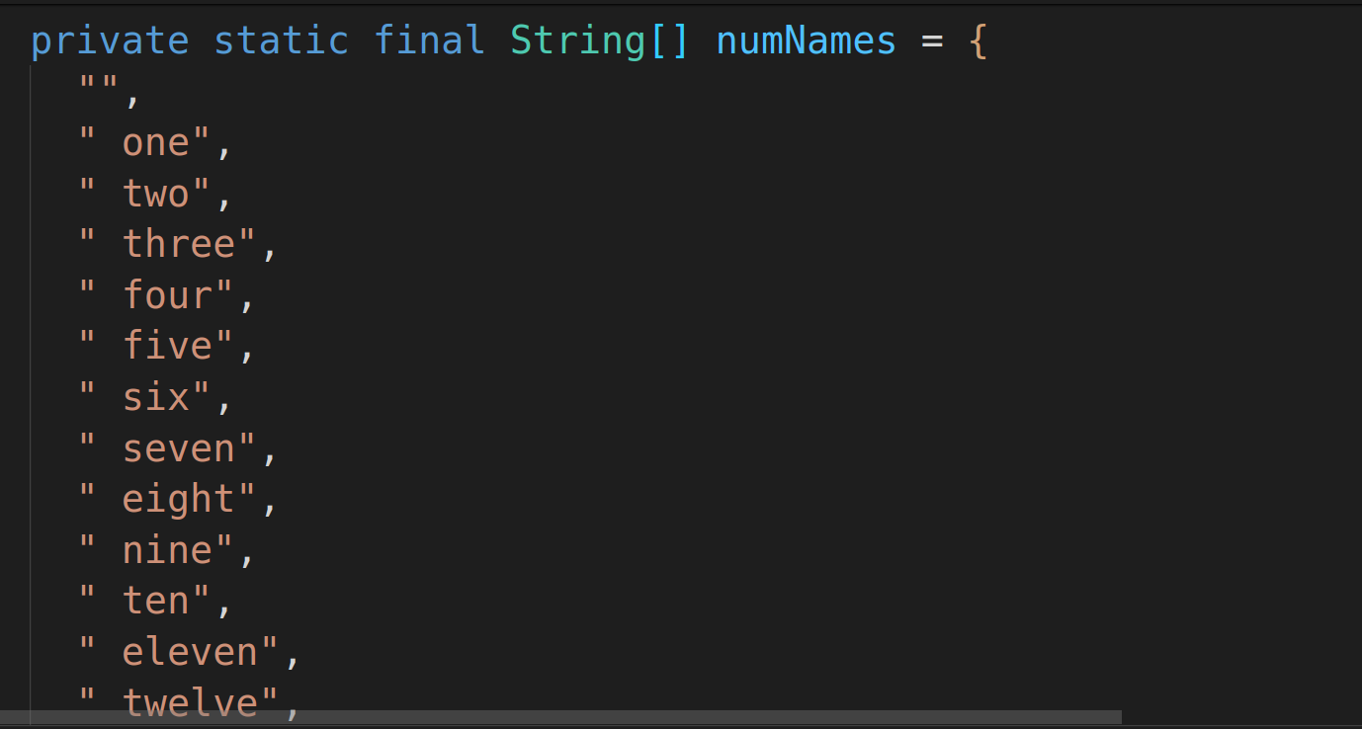

Slide 12
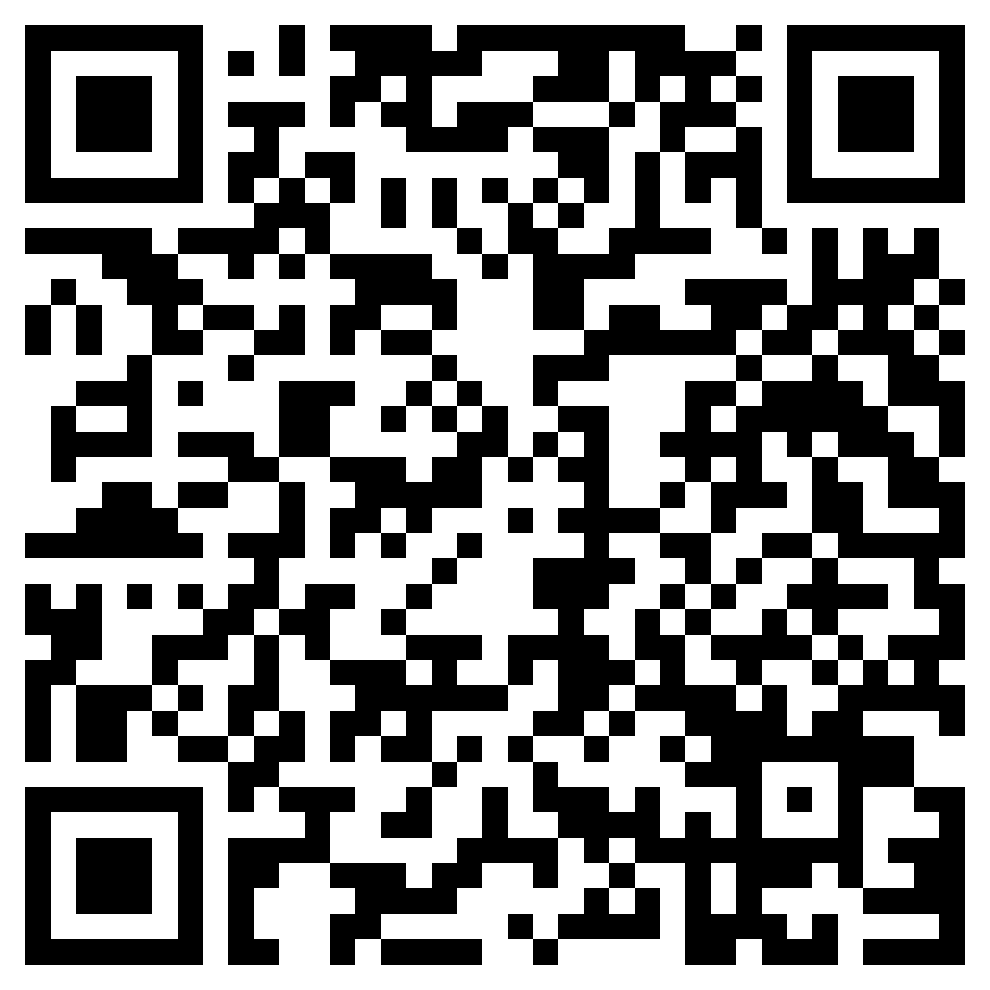
SOLUTION

Slide 13
Basic patterns

Slide 14
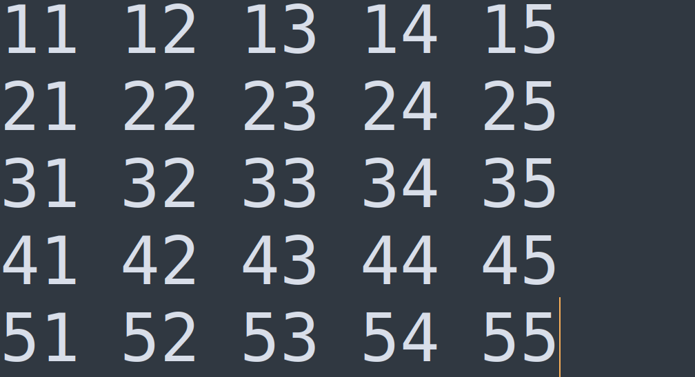

Slide 15
X pattern

Slide 16
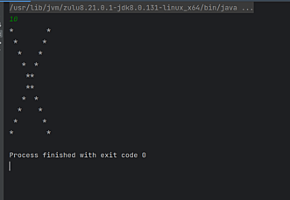

Slide 17
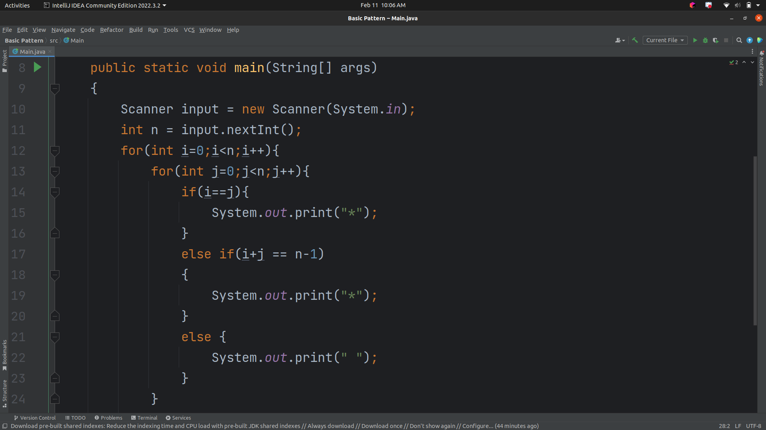

Slide 18
Odd or even

Slide 19
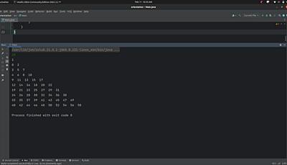

Slide 20
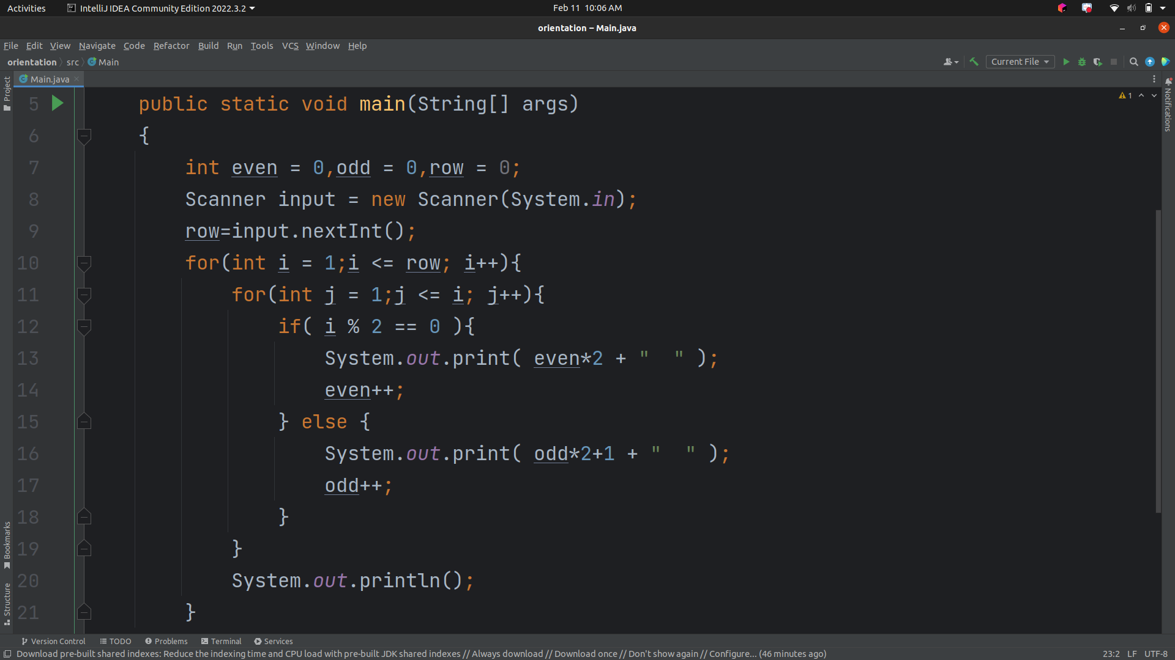

Slide 21
Rotation of array

Slide 22
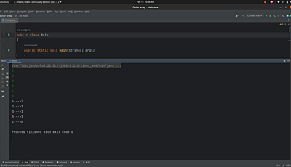

Slide 23
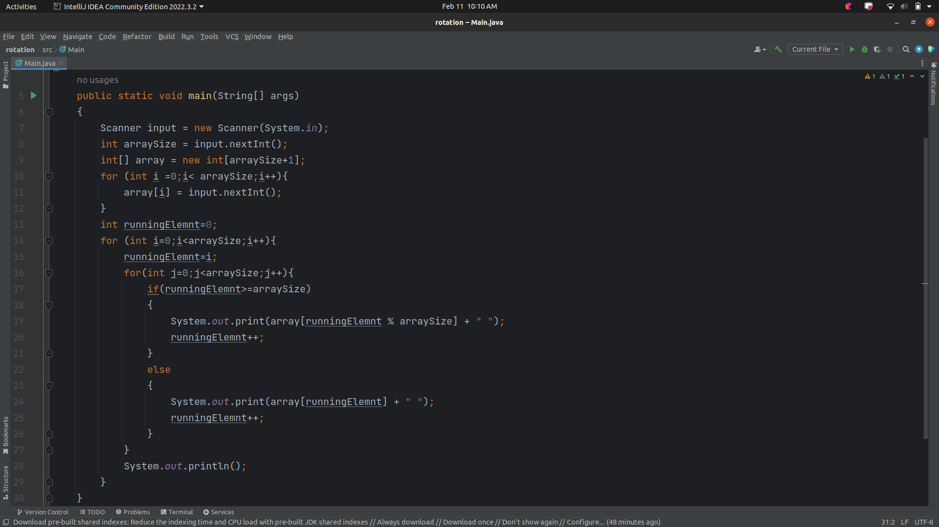

Slide 24
Sorting array based on number of factors of each element

Slide 25
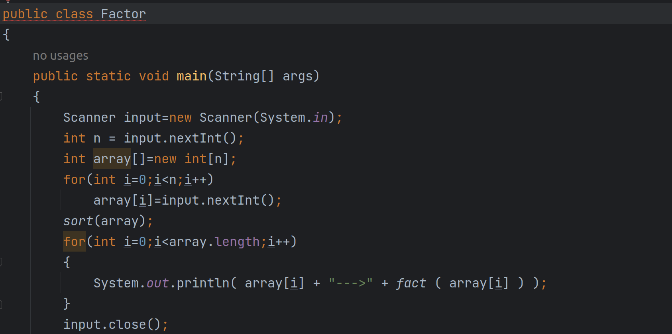

Slide 26
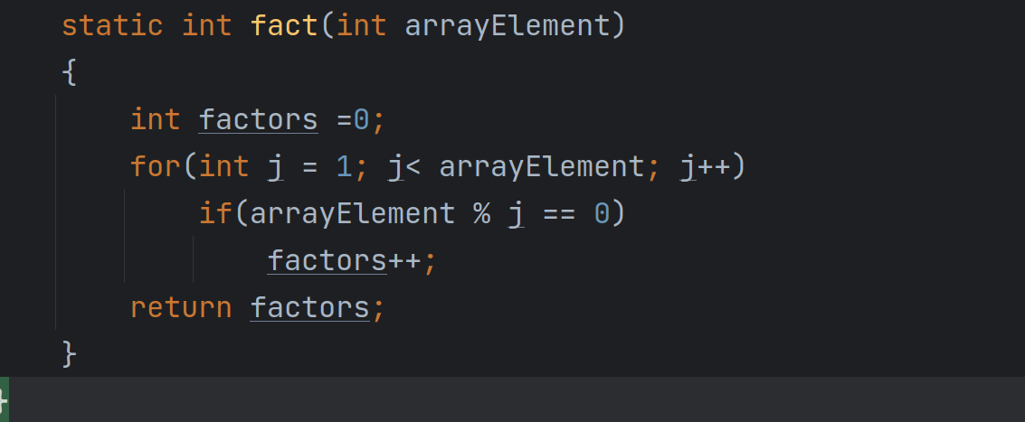

Slide 27
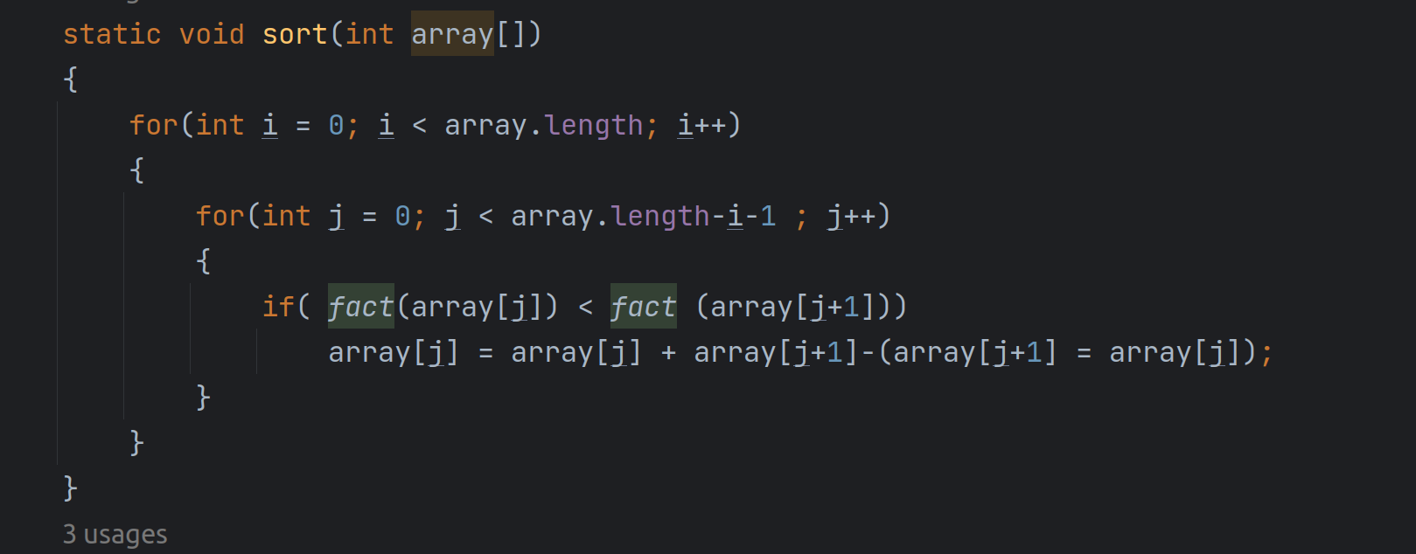

Slide 28
Next Greatest Element of all the elements in a given array
I/P : { 1 , 9 , 7 , 36 , 56 , 91 ,42 }
O/P : { 7 , 36 , 36 , 42 , 91 , -1 , -1 }

Slide 29
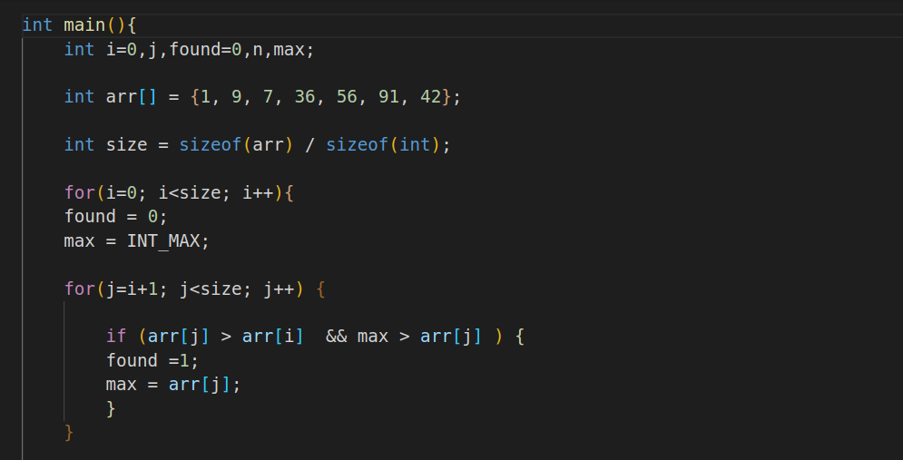

Slide 30
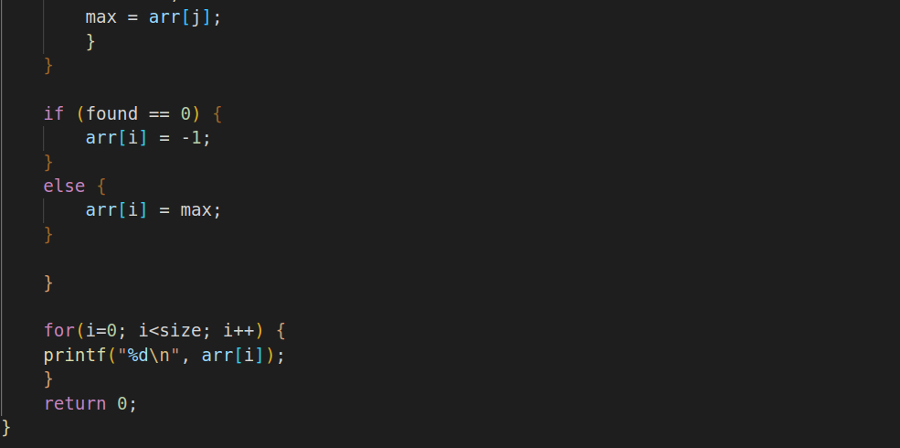

Slide 31
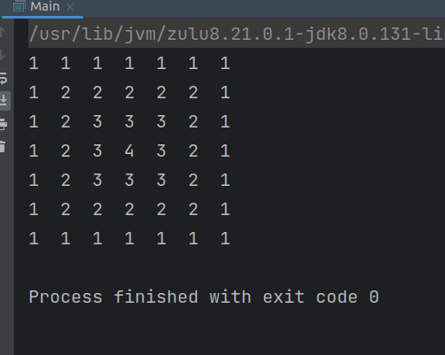

Slide 32
0 | 1 | 2 | 3 | 4 | 5 | 6 | 7
1 | 1 | 1 | 1 | 1 | 1 | 1 | 1
2 | 1 | 2 | 2 | 2 | 2 | 2 | 1
3 | 1 | 2 | 3 | 3 | 3 | 2 | 1
4 | 1 | 2 | 3 | 4 | 3 | 2 | 1
5 | 1 | 2 | 3 | 3 | 3 | 2 | 1
6 | 1 | 2 | 2 | 2 | 2 | 2 | 1
7 | 1 | 1 | 1 | 1 | 1 | 1 | 1

